Slide 1


Era
Every Moment Matters
Welcome to Era, where journeys become unforgettable.

Slide 2

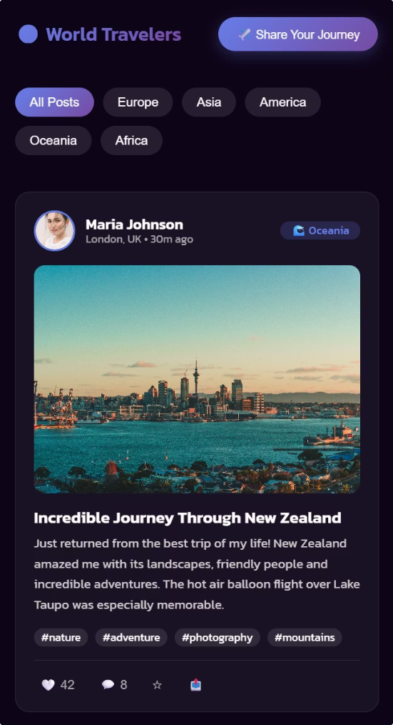




The Problem: A Fragmented Travel Experience
Today's travel often feels incomplete. We face challenges that diminish the joy of exploration.
Lonely Journeys
Feeling isolated, even in new places.
Finding Companions
Difficult to meet reliable travel partners.
Local Recommendations
Struggling to find trusted local insights.
Disjointed Platforms
No single hub for connection and planning.

Slide 3
The Solution: All-in-One Travel Platform
Era combines social networking, planning, and safety into one app — built for modern travelers.
🌍 Interactive Map
💬 Integrated Chat
✅ Verified Contacts
🗓️ Planning
Plan, discover, and explore routes with like-minded travelers.
Instant messaging and group discussions for real-time coordination.
Build trusted connections and safe travel experiences.
Organize trips, share itineraries, and stay in sync.

Slide 4





Era Chat: Connect & Communicate
Our intuitive chat feature keeps you connected with fellow travelers and local guides.
Group Chats
Coordinate with travel groups.
Private Messaging
Connect one-on-one securely.
Local Recommendations
Get instant tips from locals.
Share & Plan
Exchange photos, plans, and links.

Slide 5
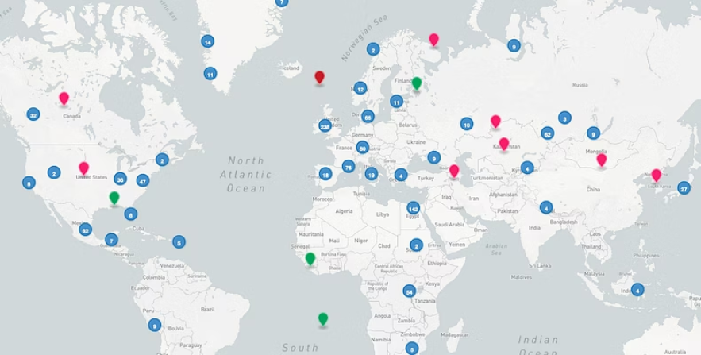
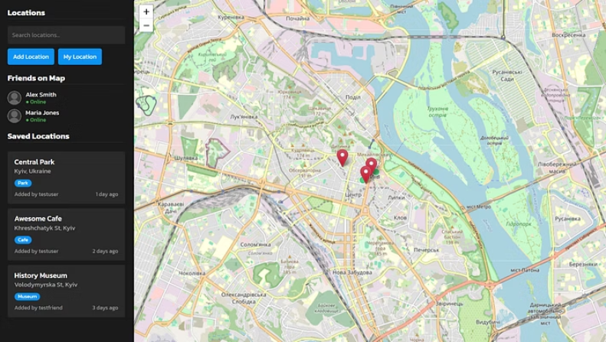
Era Map: Explore the World
With Era's interactive map, you can easily mark your location and see where your fellow travelers are. Plan your next adventure together or discover new hidden gems nearby. Era Map is the central hub for your personalized travel journey.
Explore the world and connect with fellow travelers through Era's intuitive map features.

Slide 6

Era Home: Your Personalized Travel Hub
The Era home screen provides a personalized feed of relevant travel opportunities and connections.
Tailored Suggestions
Live Updates
Discover trips based on your interests.
Stay informed on ongoing adventures.
Quick Access
Community Feed
Effortless navigation to key features.
See what fellow travelers are doing.

Slide 7


Platform
Chats
Map
Verification
Sociality
Facebook Groups
✅
❌
❌
✅
TripAdvisor
❌
✅
❌
❌
Couchsurfing
✅
❌
✅
✅
Era
✅
✅
✅
✅

Slide 8
Target Market: Global Reach
Era targets a vast, growing segment of the global travel industry:
1.4B+
$500B+
35M+
International Tourists
Travel Services Market
Digital Nomads

Slide 9



Business Model
Subscription
Advertising from Local Services
Partnerships with Travel Companies

Slide 10
Progress
Developed working prototype
Designed interface concepts
1
2
3
Defined MVP scope
What's Needed?
1
Team
2
Capital to launch MVP

Slide 11

Team Building Plan
👨‍💻 Founder: Stan - Web Developer, idea creator, worked on the concept.
📌 Plan: Hiring 3 key members:
1
UX/UI Designer
2
Full-Stack Developer
3
Marketing Specialist

Slide 12




Financial Request
📈 We're seeking $50,000 in pre-seed funding to support 6 solid months of:
MVP Development
1
UX/UI Design
2
4
Marketing Launch
3
Testing

Slide 13

Call to Action: Join Us!
🤝 We are seeking a strategist, partner, and investor to join our journey in building a global travel community.
Let's create something extraordinary together!

